Slide 1
Senior Seminar
CS 4900 Group 2
PropHop
Week 4
Wallace Coleman
Allen Kubinski Jenna Schott
Notes:
PROPHOP!!!!!!!!

Slide 2
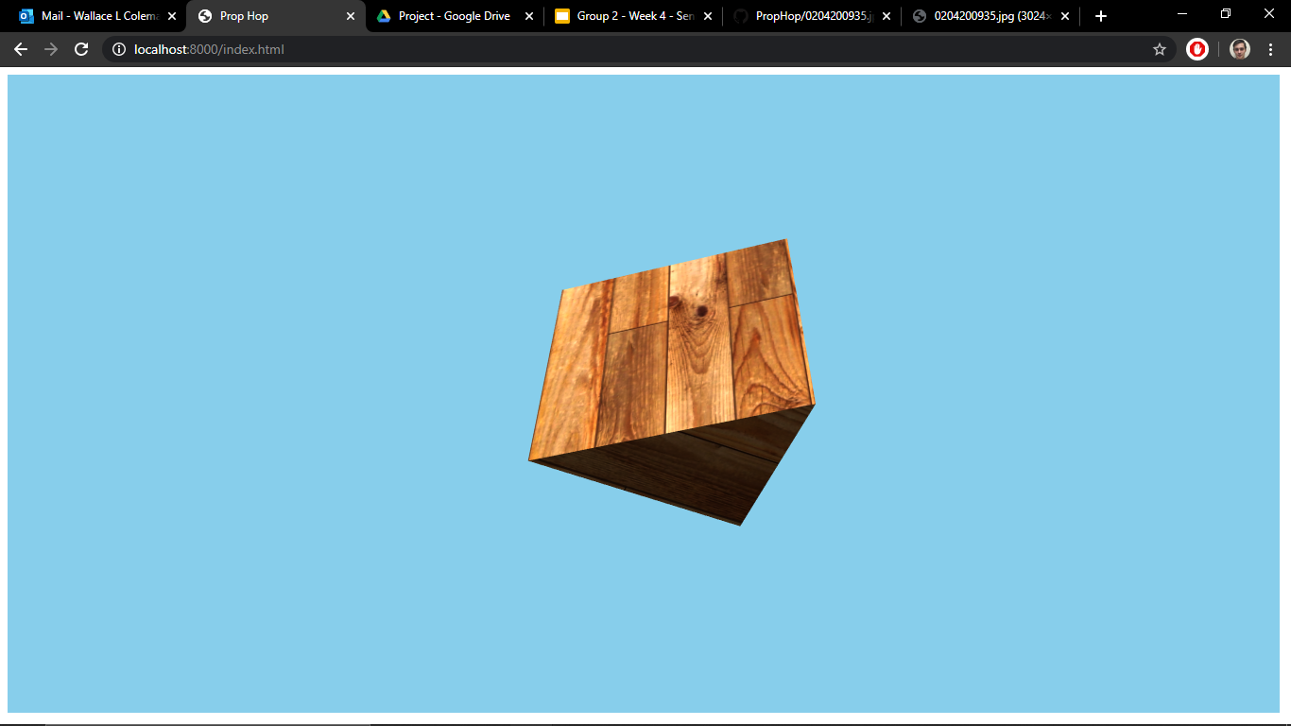
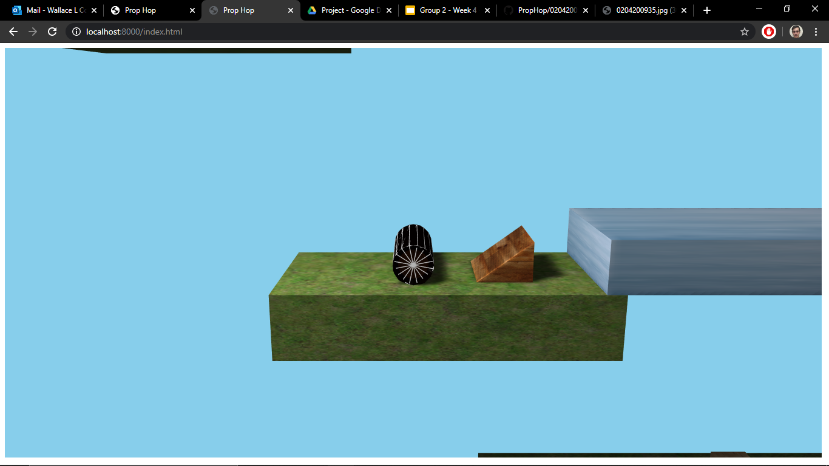
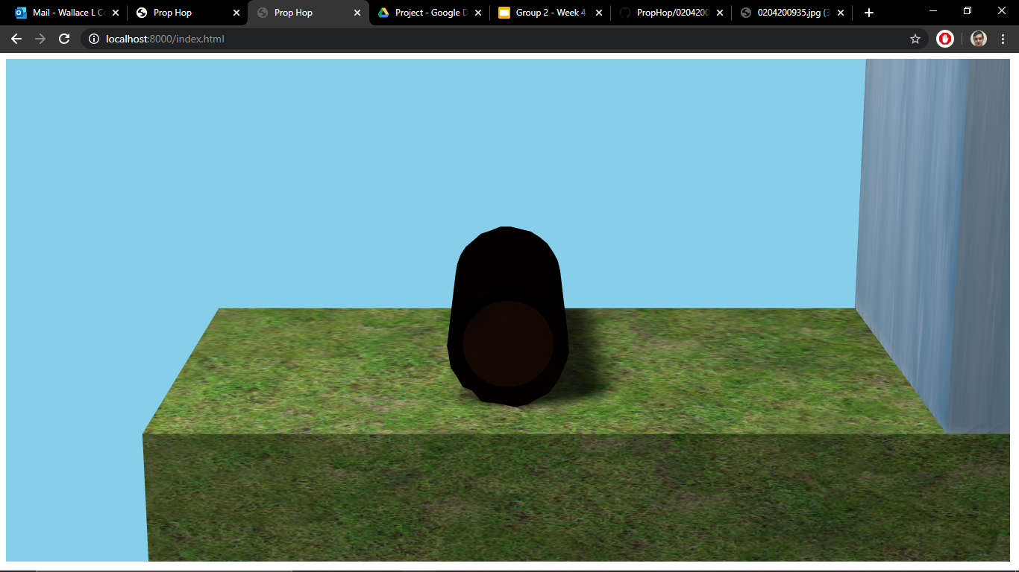
Building Blocks
Notes:
So, what we want in our game is a lot of models, that you can interact with, unfortunately there is no triangular prism or log, or lamp mesh in the physijs library. So we have to either find a similar one, like with our log or build the shape we want like with our ramp here.
Wallace: Creating and merging models to make shapes that are compatible with physijs

Slide 3
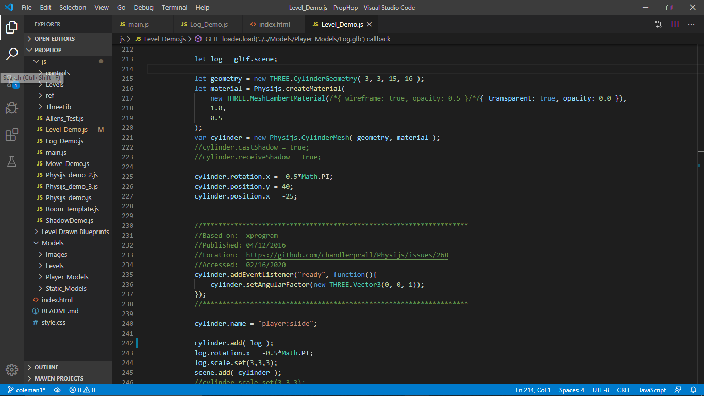
The Infamous Log
Notes:
The log is a simply a Physijs.CylinderMesh with the gltf log model added in as a child

Slide 4
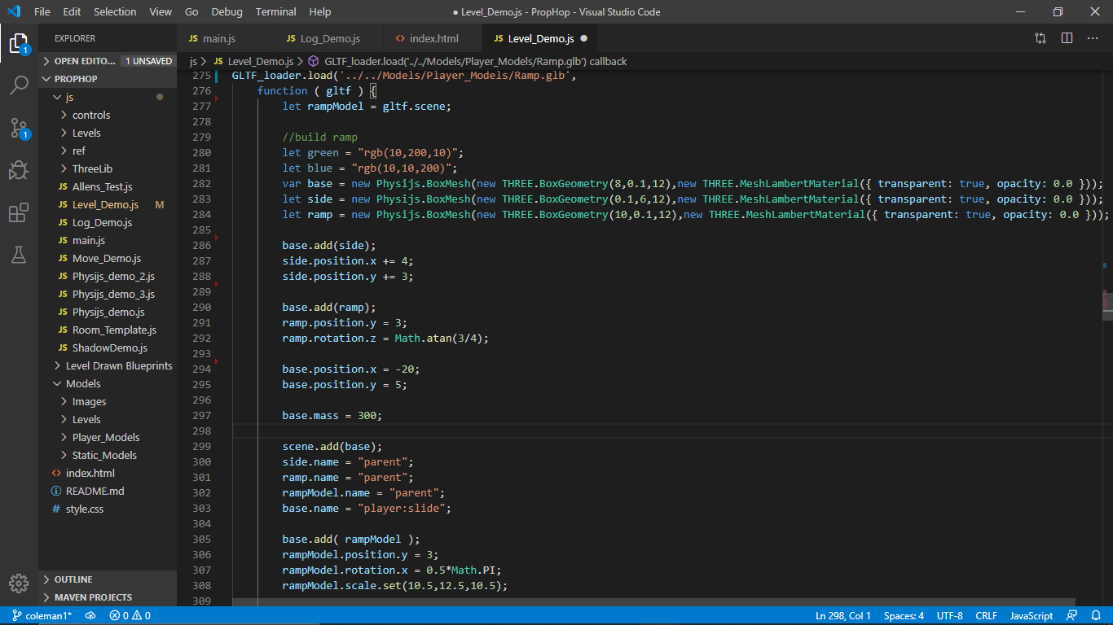
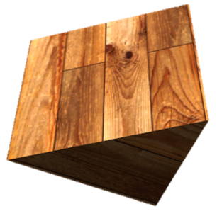
Notes:
Despite our ramp looking pretty simple, there's no basic mesh that gets the job done. Our solution is to make three thin box meshes, one for the base, one for the back, and one for the ramp part.
As you can see here, we start off with making the meshes base, side, and ramp. We then add side to base, and modify its position relative to base.
Then we add ramp to base, modify it’s relative position, an its rotation. So they now form a sort of triangle that will work for our purposes.
Finally, we add

Slide 5
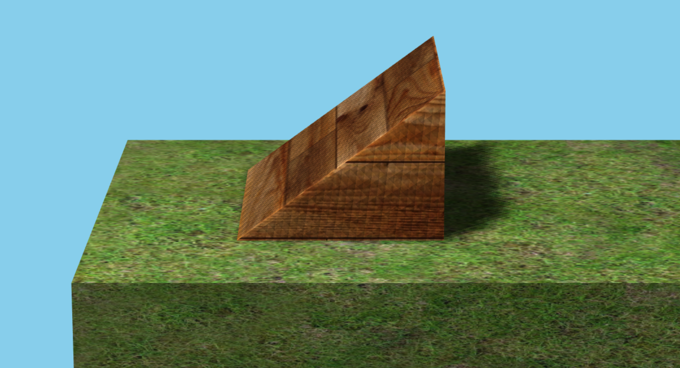
Notes:
ast week we talked about types of meshes and shadows. This week we discovered that even when we had these things coded and working, that it didn’t always look right. For example, if you look closely, you can see that there appear to be triangle shapes in our mesh. Also every time that an object moved or shifted, the triangles would move and shade differently.

Slide 6
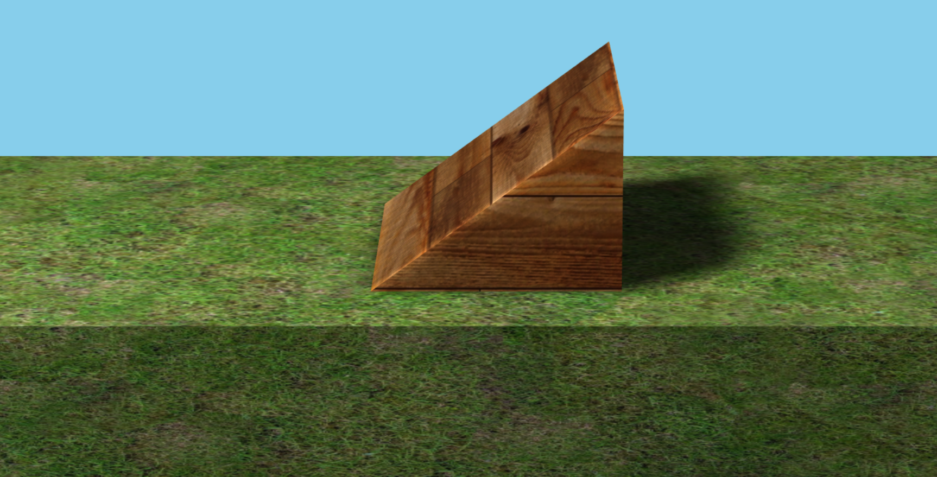
Notes:
And we can make it look a lot more natural or blended. If you can see, we still a bit shadow lines where it isn’t quite consistent.
To fix it, we used a certain kind of shadowmap called PCF Soft Shadowmap.
We wanted to make sure that we get our 3D models looking right now so that we can very easily incorporate them later on in later levels. It also helps us with level creation in case we have restrictions on certain types of models. Understanding how these models are working with threejs and our physics engine has been really important with learning how to do level design.

Slide 7
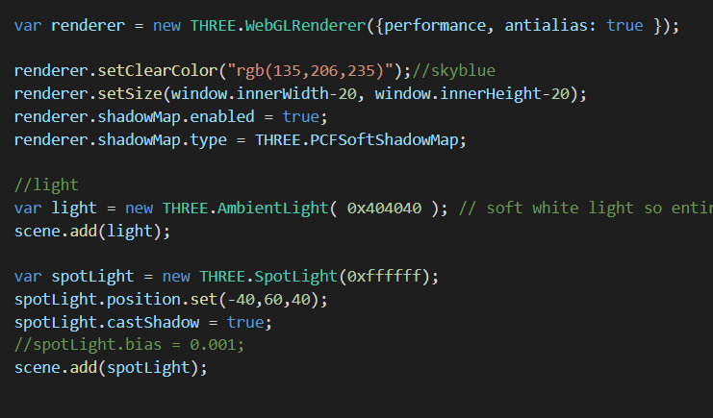
Notes:
Wallace, feel free to jump in with your shadow stuff too :)

Slide 8
Notes:
We have also been paying attention to the feedback, thank you everyone for your comments. We are trying to move forward based on some of the feedback that you have provided. For example, (next slide)

Slide 9
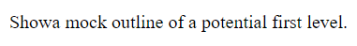
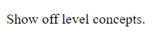
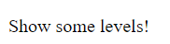
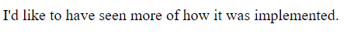
Notes:
I guess you guys wanna see a level? Does anyone want to volunteer?
//can we show a couple of my drawn levels first? YAS, totally!

Slide 10
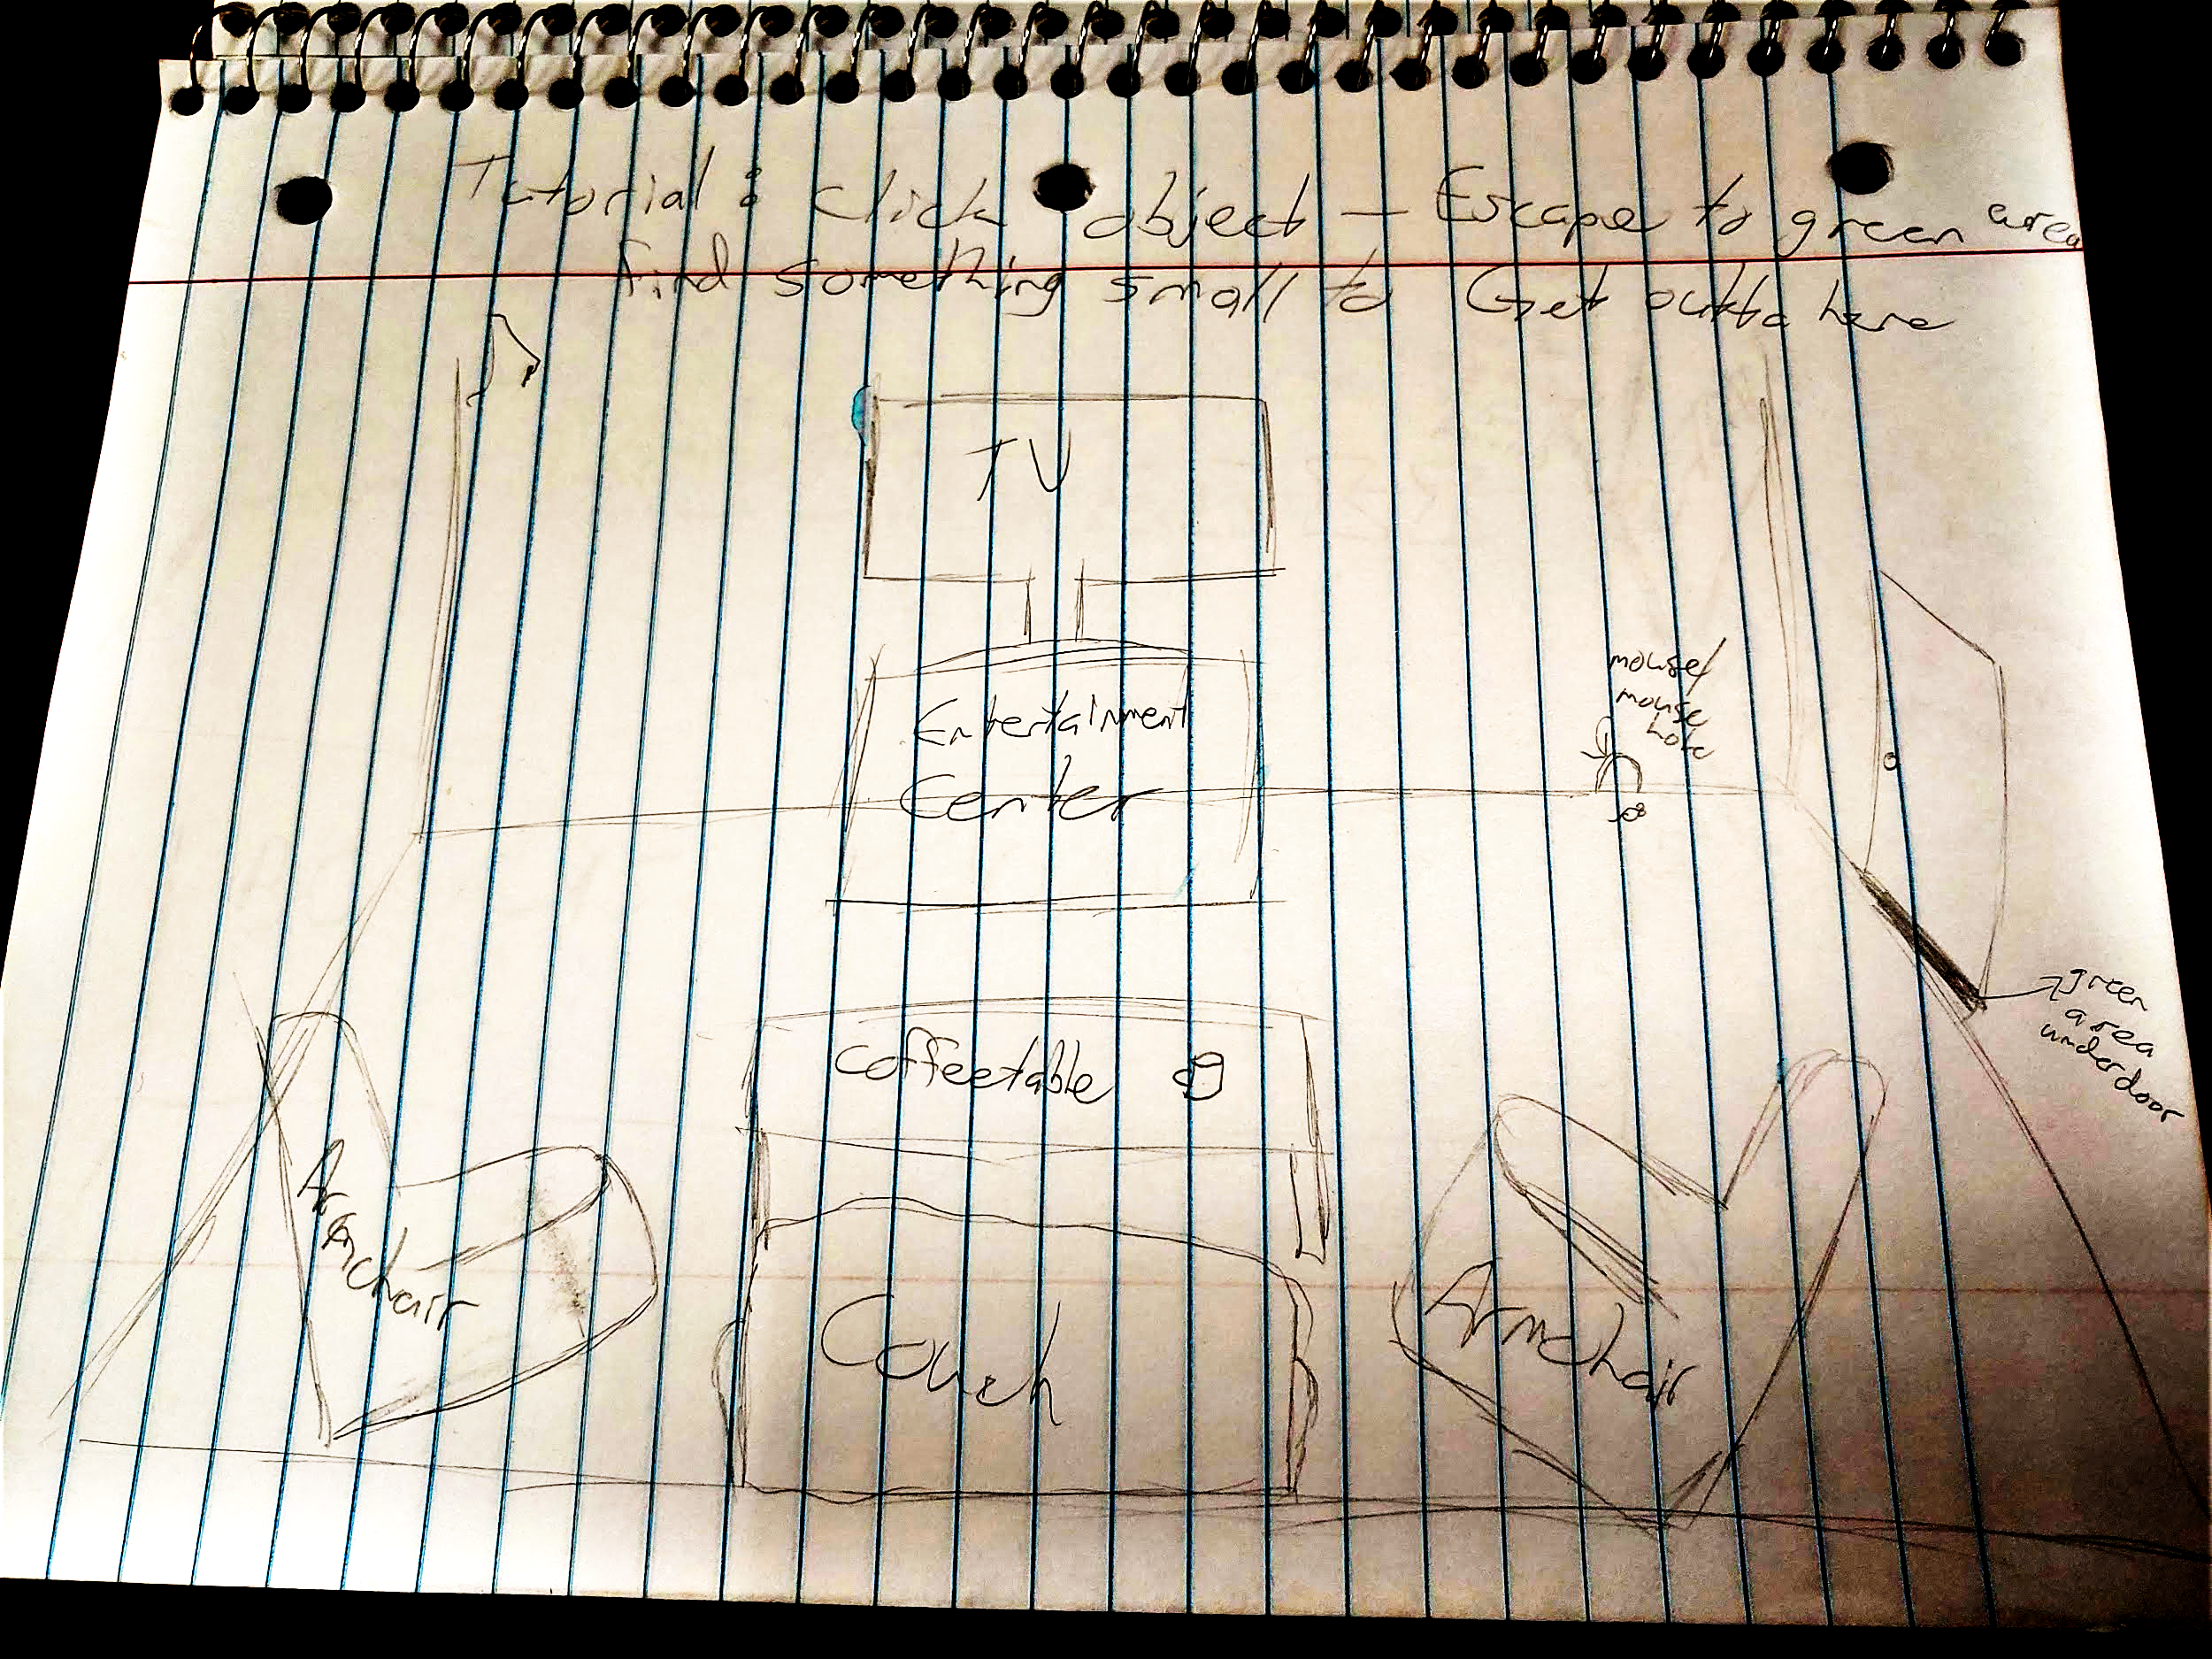

Slide 11
Click Here!

